Slide 1
Introduction to Computing and Programming: CSD101
Sweta Kumari sweta.kumari@snu.edu.in https://snu.edu.in/faculty/sweta-kumari/

Slide 2
Introduction to Computing and Programming: CSD101
Teaching assistants: Mithun Kumar (mithun.kumar@snu.edu.in)

Slide 3
Tentative Curriculum Content/Syllabus
Week 1
Introduction to Basic Fundamentals of Computers
Week 2
Introduction to Programming, Identifiers and Constants
Week 3: Data Types and Operators
Week 4
Logical Expressions and Conditional Statements
Week 5: Loops
Week 6: Arrays
Week 7: Functions, Scope of Variables
Mid-sem Exam
Week 8: Pointers
Week 9: Pointers and Arrays
Week 10
Searching and Sorting in arrays
Week 11: Strings
Week 12: Recursion
Week 13
Structures, Unions and Bit Manipulation
Week 14
File Processing
Introduction to Data Structures

Slide 4
Textbook & Reference books
Textbooks:
Brian W. Kernighan, C Programming Language, Second Edition.
Byron S Gottfried, Programming with C.
C, How to Program, 7th Edition, Paul Deitel, Harvey Deitel, PHI Learning Pvt. Ltd. ISBN: 8120348273.
Programming in Ansi C by Balaguruswamy, https://aiict.edu.bd/wp-content/uploads/2022/09/ansi-c-balaguruswamy-c-language-PDFDrive.com-.pdf
Reference Book:
Let Us C By Yashavant P. Kanetkar, http://pdvpmtasgaon.edu.in/uploads/dptcomputer/Let%20us%20c%20-%20yashwantkanetkar.pdf
Notes:
Refer first 2 books for concepts and last one for practice.

Slide 5
Assessment Strategy
Type of Assessment | Description | Percentage (%)
Assignments | These could be theoretical/numerical questions based on concepts taught in class. | 30
Quizzes (Best 2 out of 3) | Subjective | 10
Surprise Quiz | Subjective/Objective | 5
Midterm Exam | Subjective + Objective | 20
Final Exam | Subjective + Objective | 35
 | Total | 100
Notes:
Assignments Split (30):
4 Graded labs including viva (Best of 3)- 15
10 Labs including assignments -15

Slide 6
Grading Policy
Grading will be relative in this course.
Minimum passing marks will be 30%.
Estimated minimum for getting an A grade will be 85%. The actual cutoff of A grade may be higher depending on the relative performance of the class.

Slide 7
Course Policy
Attendance policy: Attendance must be maintained as per university policy where non-compliance would lead to an F∗ grade. 75% attendance is mandatory.
Academic malpractice policy: There is a zero-tolerance policy on cheating and malpractice during exams and assignments. Use of mobile phones and other electronic devices is not allowed during lectures and problem sessions.
Policy on make-up exams: A make-up exam for any graded component will only be conducted based on genuine medical ground or other unavoidable circumstances, where condonement is approved by the Dean’s office. There will be one common make-up exam for all the missed graded components.
Plagiarism checker for Assignments & Projects: Zero marks will be given for the assignment if the similarity will be more than 40%.

Slide 8
Introduction to Computing and Programming

Slide 9
Content
Motivation
What is Computing?
What is Computer?
Functions of Computer
Components of Computer
  Hardware
  Software
  Users
Types of Computers

Slide 10
Motivation of this Course
The course teaches you how to solve problems using the computer.
Every discipline uses computing: All branches of engineering, sciences, design and arts.
In this course, all problems will be defined precisely and will be simple.
Obtain a logical solution to your problem. A logical solution is a finite and clear step-by-step procedure to solve your problem, also called an algorithm.
We can visualize this using a flowchart.
Eventually, we will do coding in C language.
Notes:
I feel we should keep some example to motivate

Slide 11
What is Computing?

Slide 12
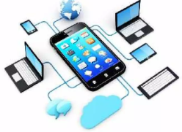
What is Computing?
The process of utilizing computer technology to complete a task.
Computing may involve computer hardware and/or software, but must involve some form of a computer system.
Designing, developing, building hardware & software systems, Processing, doing scientific research on and with computers, entertainment media, etc.
Most individuals use some form of computing every day whether they realize it or not.
Example: Swiping a debit card, sending an
email, or using a cell phone, etc.

Slide 13
What is Computer?

Slide 14

What is Computer?
An Electronic device that stores, retrieves, and processes data and can be programmed with instructions.
Takes raw data as input from the user and processes these data under the control of set of instructions (called program) and gives the result (output) and saves output for the future use.
It can process both numerical and non-numerical (arithmetic and logical) calculations.

Slide 15
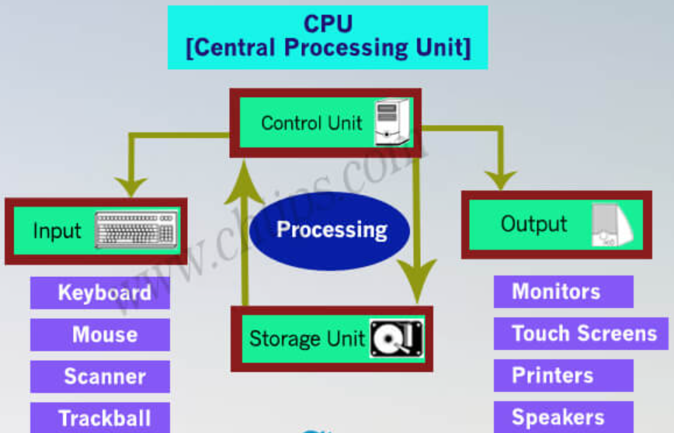
Functions of Computer
There are four functions of Computer:
Accepts data (INPUT): Raw information entered into a computer from the input devices
Processes data (Processing) : The operation of data as per given instruction
Produces output (OUTPUT) : The processed data given by computer after data processing
Stores results (Storage): Save these results in the storage devices for the future use.

Slide 16
Components of Computer
COMPUTER SYSTEM = HARDWARE + SOFTWARE+ USER

Slide 17
Hardware Components
Hardware=Internal Devices + Peripheral Devices.
All physical parts of the computer (or everything that we can touch) are known as Hardware.
Major parts of the computer are:
  Input Devices
  Processors
  Output Devices
  Storage Devices
  Peripheral Devices
  Internal Components

Slide 18
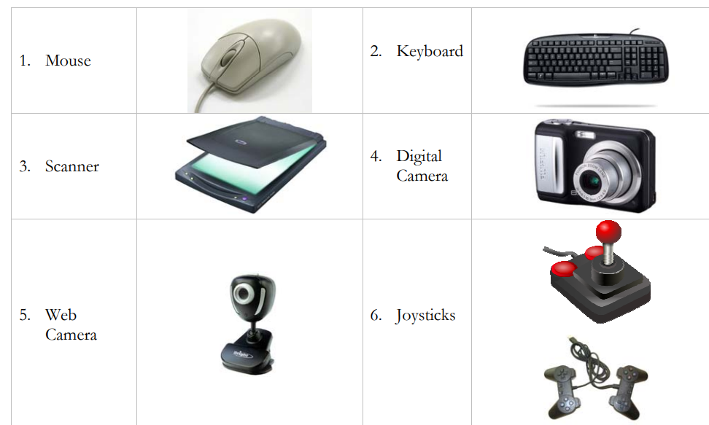
Hardware Components
Examples of Input Devices
Track ball, Touch pad, Light pen, Bar code reader, Microphone, Tablet, etc.

Slide 19
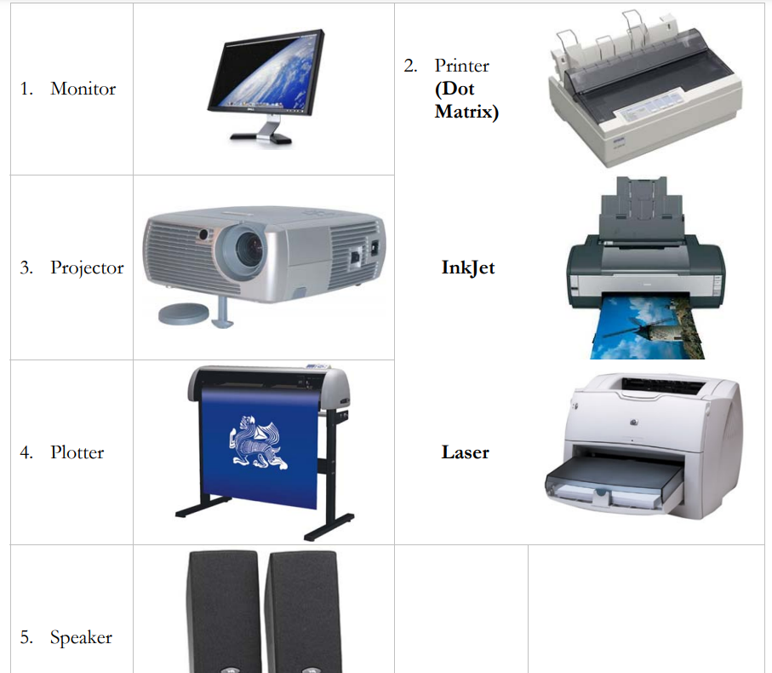
Hardware Components
Examples of Output Devices

Slide 20
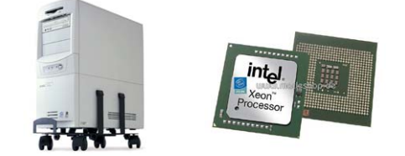
Hardware Components
Processors
The main unit inside the computer is the CPU (Central Processing Unit).
This unit is responsible for all events inside the computer.
It controls all internal and external devices, performs arithmetic and logic operations. The CPU is the device that interprets and executes instructions.

Slide 21
Hardware Components
Storage Devices
1. Primary memory (main memory)
  RAM (Random Access Memory/Read-Write Memory)
  ROM (Read-only-memory)
2. Secondary memory (storage devices)
  Hard Disk (Local Disk)
  Optical Disks: CD-R, CD-RW, DVD-R, DVD-RW
  Pen Drive
  Zip Drive
  Floppy Disks
  Memory Cards
  External Hard Disk

Slide 22
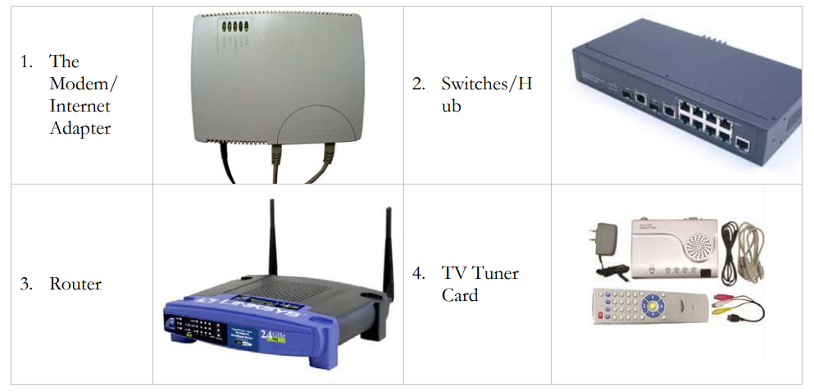
Hardware Components
Peripheral Devices

Slide 23
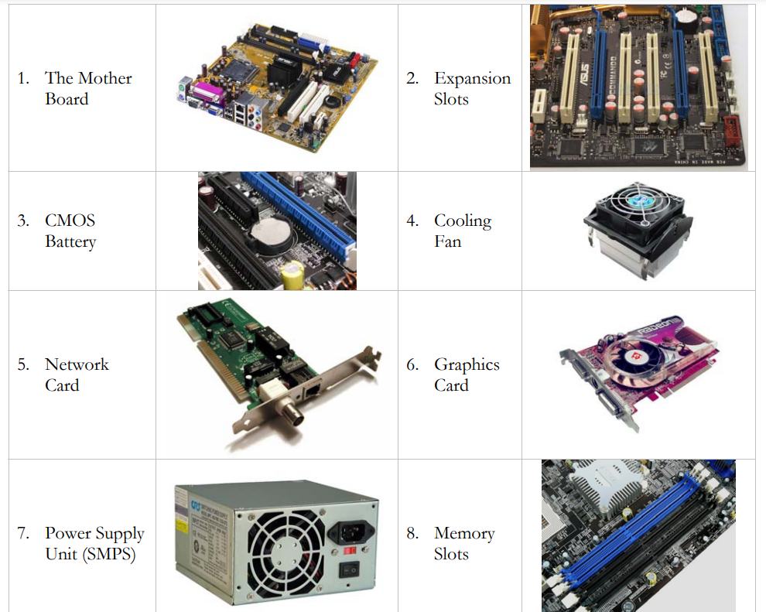
Hardware Components
Internal Components

Slide 24
Software Components
Software = Computer Programs
Software gives "intelligence" to the computer.
Software is the set of programs, which are used for different purposes.
All the programs used in computer to perform specific task is called Software.

Slide 25
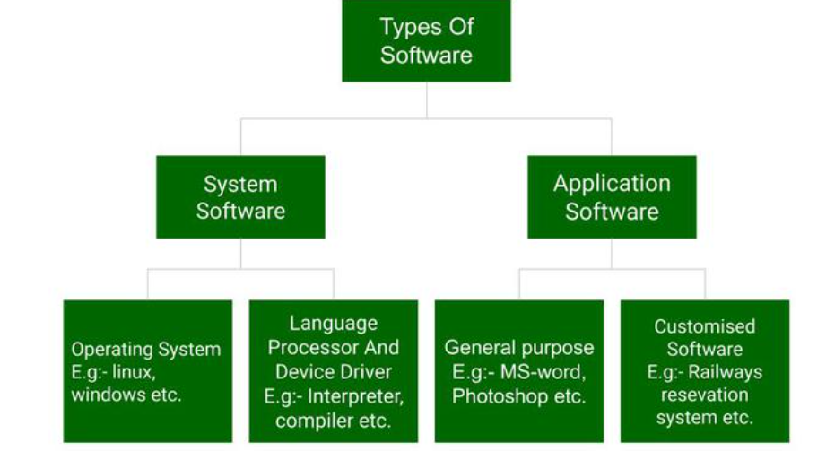
Software Components Cont..
Types of Software:

Slide 26
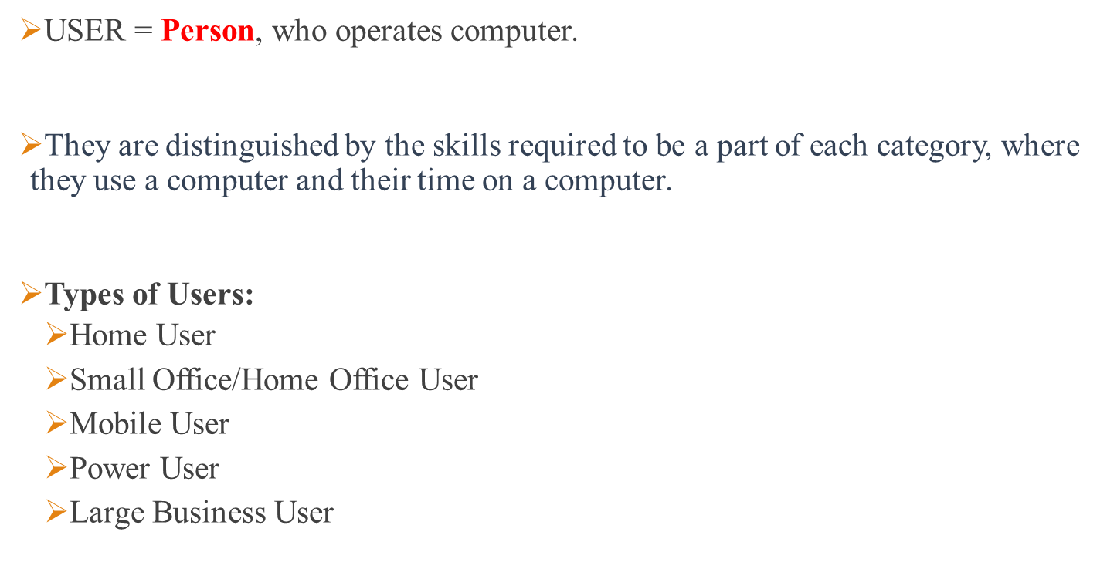
Users Components

Slide 27
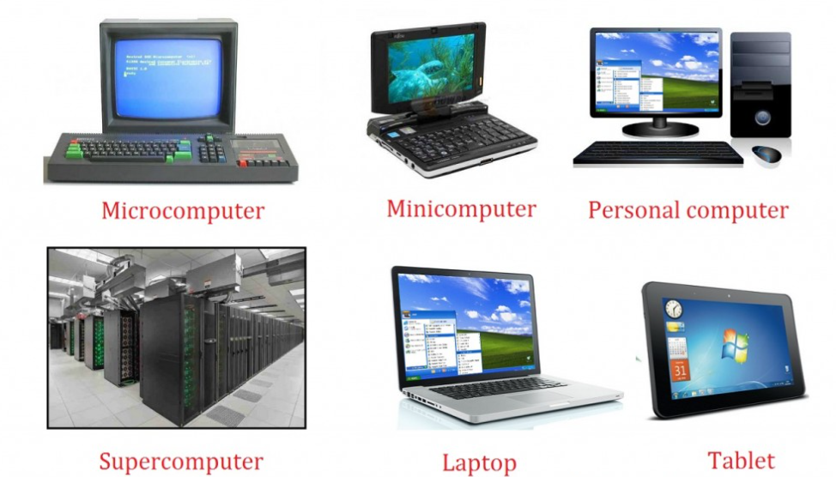
Types of Computer

Slide 28
Upcoming topics
  What do computer understand
  Decimal to Binary Conversion

